Slide 1
Language Detection using NLP
Nilakrishna M

Slide 2
objective
To build NLP model to predict 17 different languages.
Dataset : language detection dataset taken from Kaggle. This dataset consists of text details for 17 different languages like English, Malayalam, French, Russian etc.
Machine learning problem type : Classification (Supervised Learning)
Methods used : Natural language processing, Naive Bayes
Evaluation metric : Accuracy

Slide 3
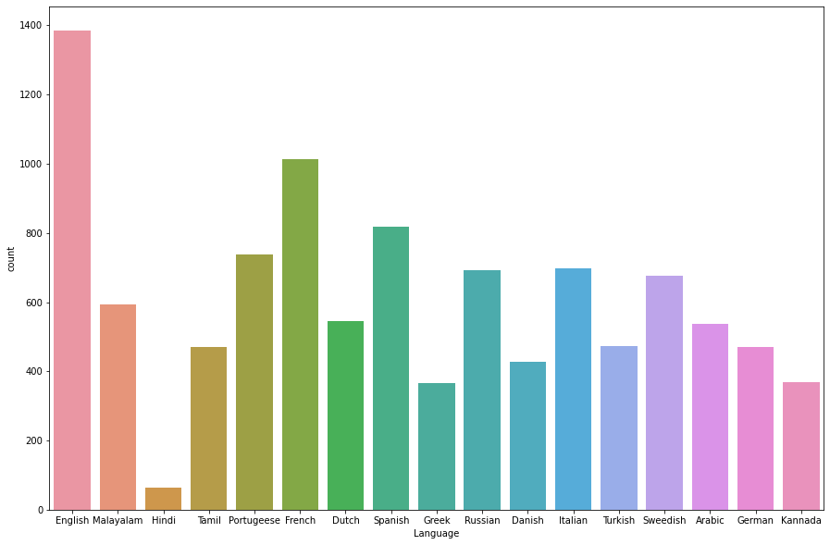
Count plot

Slide 4
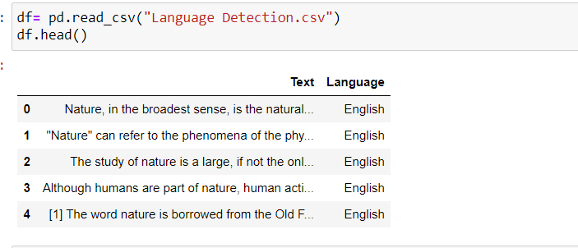
Implementation
Loading data

Slide 5
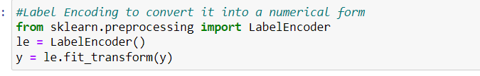
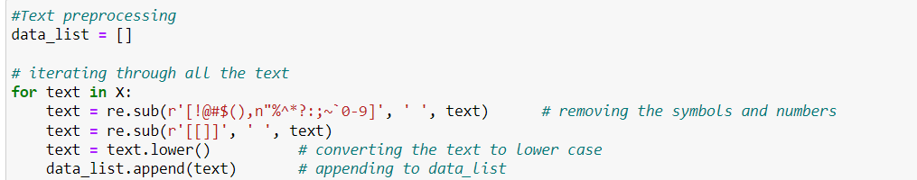
Preprocessing
2. Label encoding of target variable Language
3. Text preprocessing

Slide 6
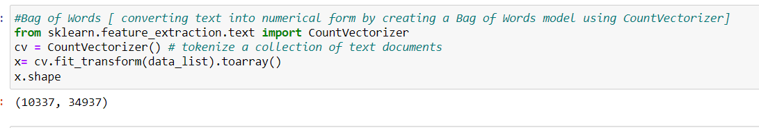
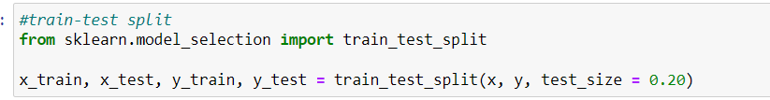
3. Vectorization using Bag of words
4. Splitting into train and test data

Slide 7
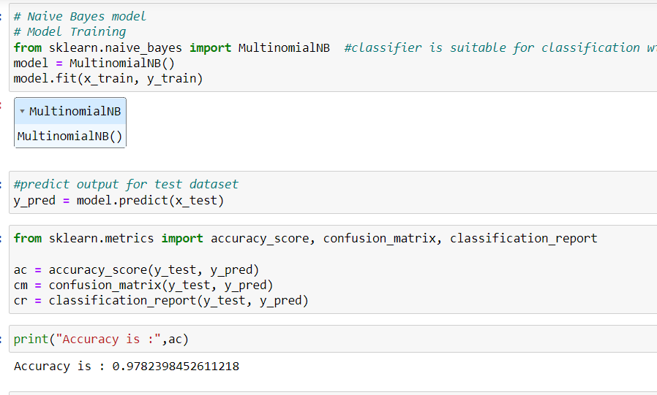
5. Naive Bayes Model

Slide 8
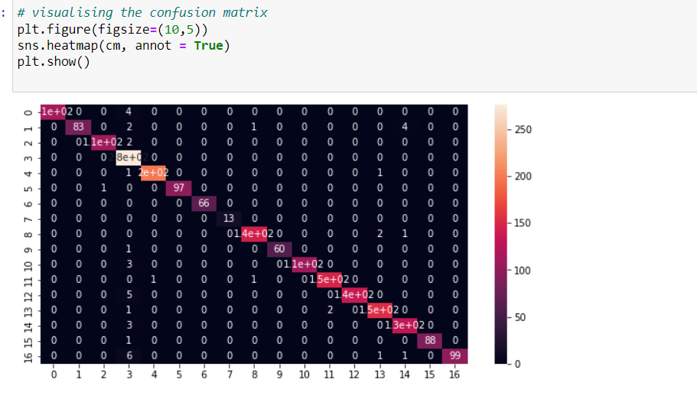
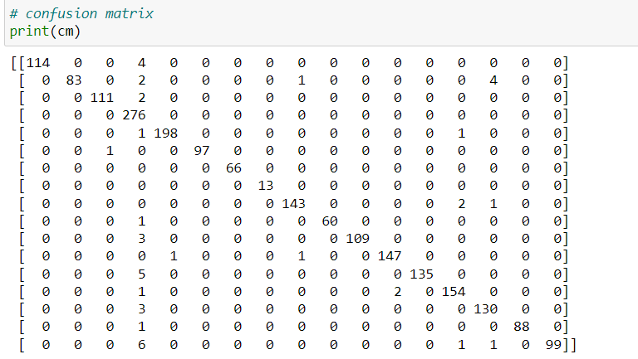
6. Visualizing confusion matrix using heat map

Slide 9
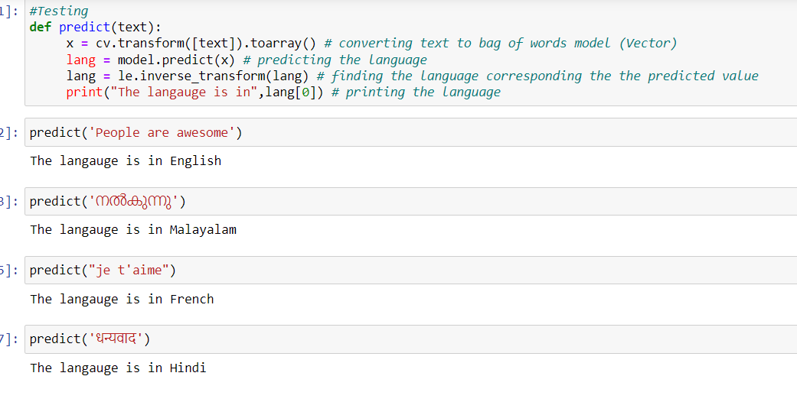
7. Model Testing

